Slide 1
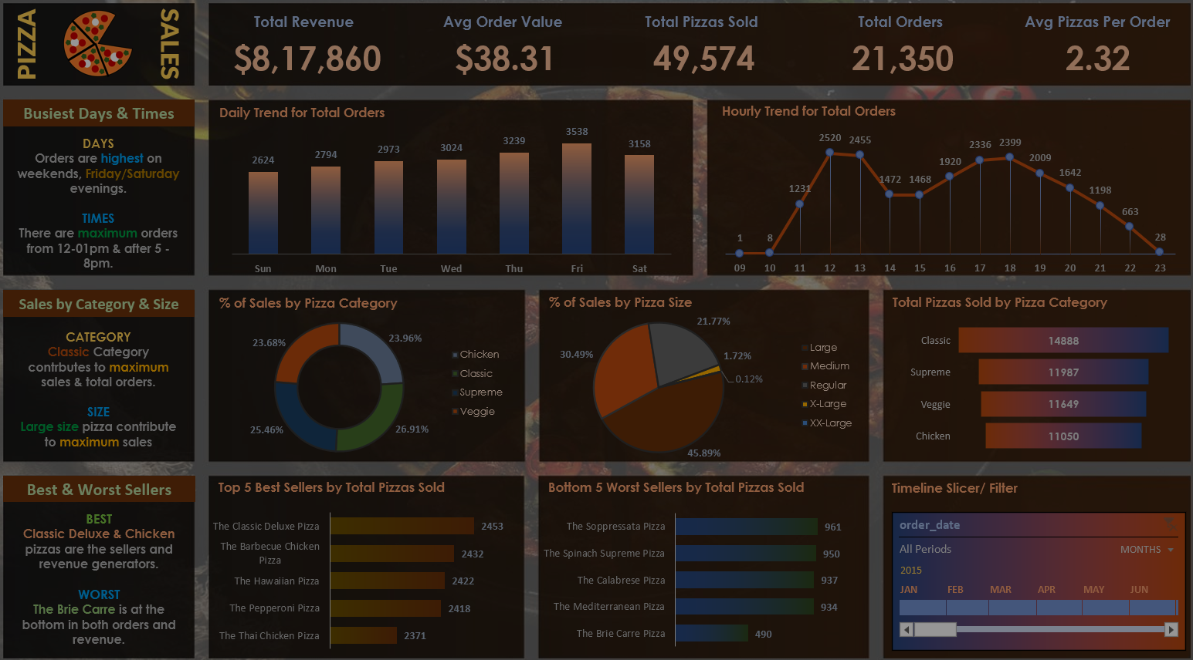


DATA ANALYST PORTFOLIO PROJECT
POWER BI

Slide 2

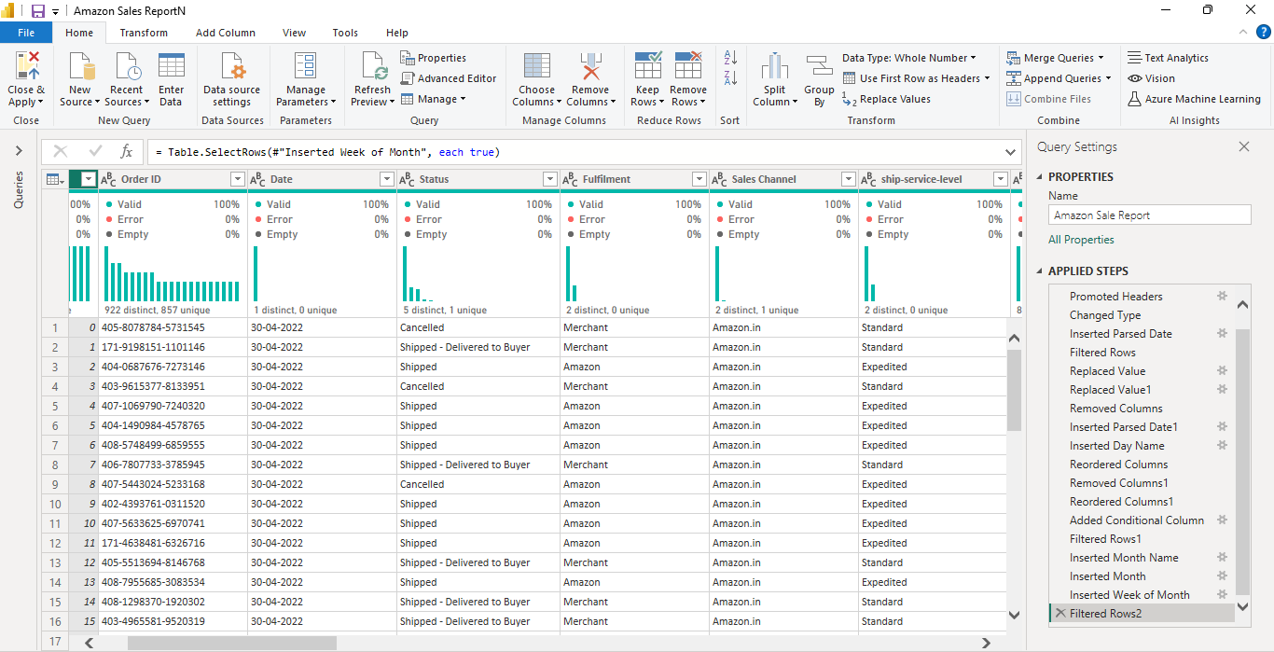
POWER BI
DATA
PROCESSING

Slide 3
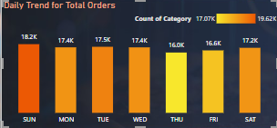

POWER BI
DATA
VISUALIZATION

Slide 4
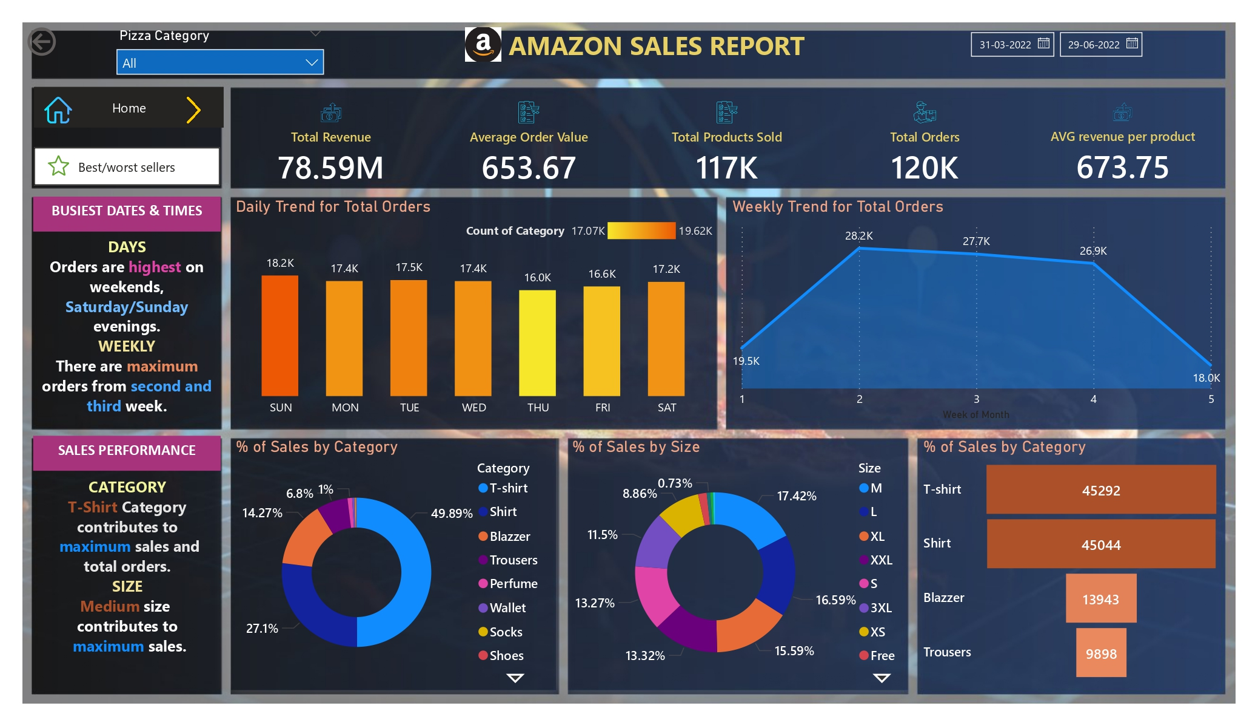
POWER BI
REPORT/ DASHBOARD

Slide 5
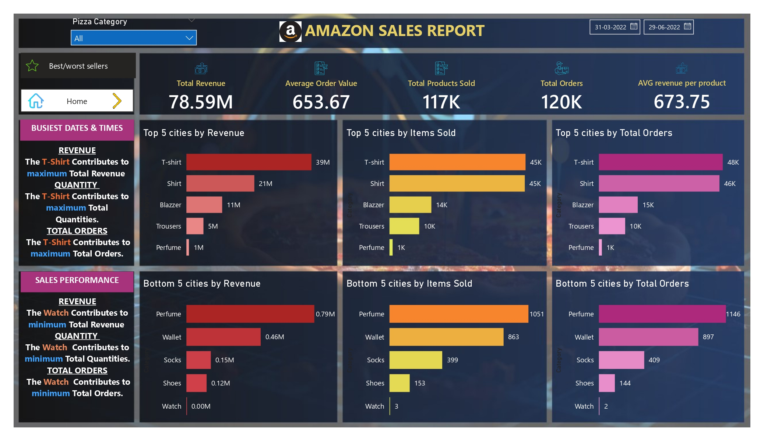
POWER BI
REPORT/ DASHBOARD

Slide 6
PROBLEM STATEMENT
KPI’s REQUIREMENT
We need to analyze key indicators for our amazon sales data to gain insights into our business performance. Specifically, we want to calculate the following metrics:
Total Revenue: The sum of the total price of all orders.
Average Order Value: The average amount spent per order, calculated by dividing the total revenue by the total number of orders.
Total Products Sold: The sum of the quantities of all Products sold.
Total Orders: The total number of orders placed.
Avg Revenue Per Item: The average revenue of Products sold per order, calculated by dividing the total Revenue by the total number of Products sold.

Slide 7
PROBLEM STATEMENT
CHARTS REQUIREMENT
We would like to visualize various aspects of our Products sales data to gain insights and understand key trends. We have identified the following requirements for creating charts:
Daily Trend for Total Products Sold:
Create a stacked bar chart that displays the daily trend of total orders over a specific time period. This chart will help us identify any patterns or fluctuations in order volumes on a daily basis.
2.Weekly Trend for Total Orders:
Create a line chart that illustrates the weekly trend of total orders throughout the Month. This chart will allow us to identify peak weeks or periods of high order activity.
3.Percentage of Sales by Category:
Create a pie chart that shows the distribution of sales across different Products categories. This chart will provide insights into the popularity of various categories and their contribution to overall sales.

Slide 8
PROBLEM STATEMENT
CHARTS REQUIREMENT
4.Percentage of Sales by Product Size:
Generate a pie chart that represents the percentage of sales attributed to different product sizes. This chart will help us understand customer preferences for product sizes and their impact on sales.
5.Total Products Sold by Product Category:
Create a funnel chart that presents the total number of product sold for each Products category. This chart will allow us to compare the sales performance of different Products categories.
6.Top 5 Best Sellers by Revenue, Total Quantity and Total Orders
Create a bar chart highlighting the top 5 best-selling Products based on the Revenue, Total Quantity, Total Orders. This chart will help us identify the most popular Products options.
7. Bottom 5 Best Sellers by Revenue, Total Quantity and Total Orders
Create a bar chart showcasing the bottom 5 worst-selling Products based on the Revenue, Total Quantity, Total Orders. This chart will enable us to identify underperforming or less popular Products options.

Slide 9
SOFTWARE USED
MS OFFICE/ EXCEL: VERSION 2021
POWER BI: VERSION 2024

